Slide 1

Gantt Chart
Module 3
Dr. Hitesh Mohapatra

Slide 2
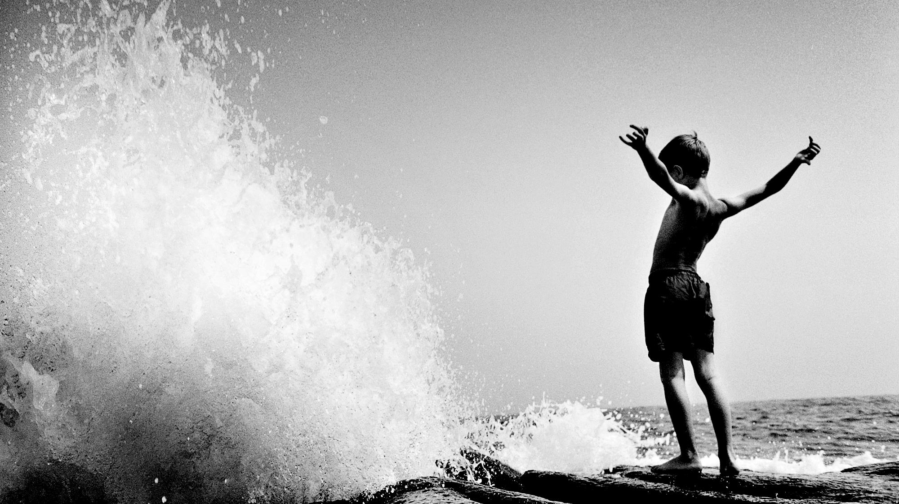
Origin
In the early part of the 20th century, Henry Gantt revolutionized project management with Gantt charts. At that time, they were written out on pieces of paper. With the rise of computers in the 1980s, Gantt charts became increasingly complex and elaborate. Today, Gantt charts are still one of the most widely used project management tools.

Slide 3
A Gantt chart, commonly used in project management, is one of the most popular and useful ways of showing activities (tasks or events) displayed against time.
On the left of the chart is a list of the activities and along the top is a suitable time scale. Each activity is represented by a bar; the position and length of the bar reflects the start date, duration and end date of the activity.
  What the various activities are:
  When each activity begins and ends
  How long each activity is scheduled to last
  Where activities overlap with other activities, and by how much
  The start and end date of the whole project

Slide 4
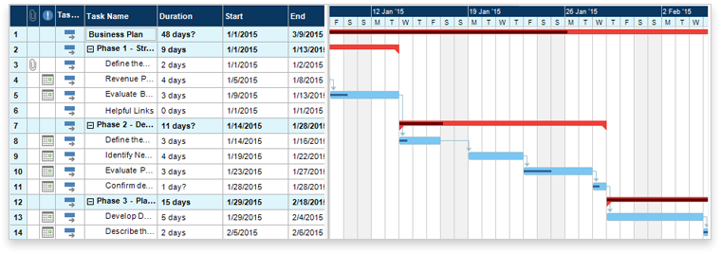
To summarize, a Gantt chart shows you what has to be done (the activities) and when (the schedule).

Slide 5
What is a Gantt chart used for?
Build and manage a comprehensive project
Gantt charts visualize the building blocks of a project and organize it into smaller, more manageable tasks. The resulting small tasks are scheduled on the Gantt chart's timeline, along with dependencies between tasks, assignees, and milestones.
Project managers use Gantt charts for three main reasons:
Reason 1

Slide 6
Cont..
Determine logistics and task dependencies
Gantt charts can be employed to keep an eye on the logistics of a project. Task dependencies ensure that a new task can only start once another task is completed. If a task is delayed (it happens to the best of us), then dependent issues are automatically rescheduled. This can be especially useful when planning in a multi-team environment.
Reason 2

Slide 7
Cont..
Monitor progress of a project
As teams log time towards issues in your plan, you can monitor the health of your projects and make adjustments as necessary. Your Gantt chart can include release dates, milestones, or other important metrics to track your project’s progress.
Reason 3

Slide 8
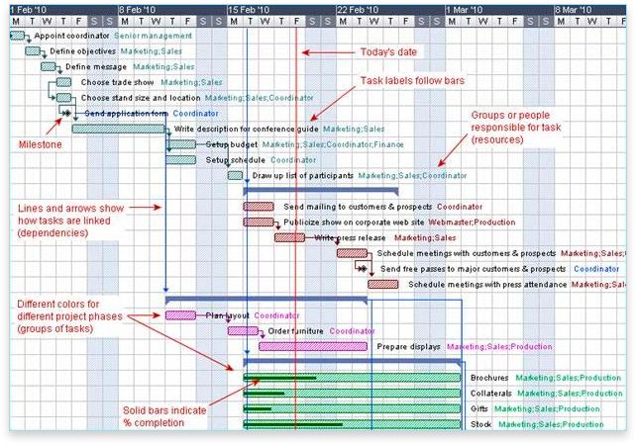
WELLSPRING

Slide 9

Summary
Today, Gantt charts are most commonly used for tracking project schedules. For this it is useful to be able to show additional information about the various tasks or phases of the project, for example how the tasks relate to each other, how far each task has progressed, what resources are being used for each task and so on.

